Slide 1
ProCAT: a data analysis approach for protein microarrays
Yale University
Xiaowei Zhu, Mark Gerstein and Michael Snyder
Genome Biol 2006

Slide 2
Outline
Background
Introduction
Module 1~6
Conclusion

Slide 3
Background
Functional protein microarrays are used to identify protein–protein, protein–DNA, protein–RNA, and protein–small-molecule interactions, to assay enzymatic activity and to detect antibodies demonstrate their specificity.
The analytical protein microarray (antibody microarray) is probed with a complex protein solution. Analysis of the resulting binding reactions using various detection systems can provide information about expression levels of particular proteins in the sample as well as measurements of binding affinities and specificities. This type of microarray is especially useful in comparing protein expression in different solutions.

Slide 4
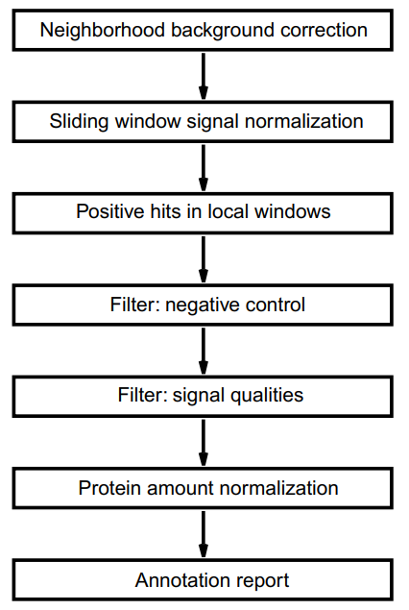
Introduce

Slide 5
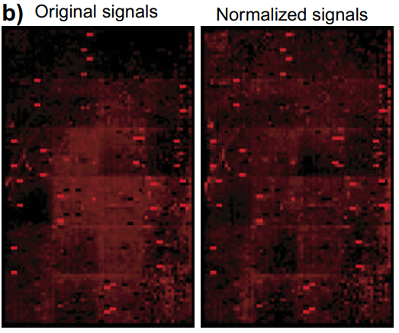
Module 1: background corrections to reduce smear contaminations
Aims at reducing noise in background quantification.
Signal intensities are generally quantified by subtracting the foreground intensities with the local background intensities, which are measured as the background signals immediately surrounding the spot of interest. However, in protein microarrays local background regions can be easily skewed by artifacts such as small speckles; strong positive signals from on-chip kinase assays tend to produce signal smears on both film and phosphoimagers (磷光影像掃描分析儀) that exceed the normal feature size.In both cases, the measurement for that spot will be inaccurate.

Slide 6
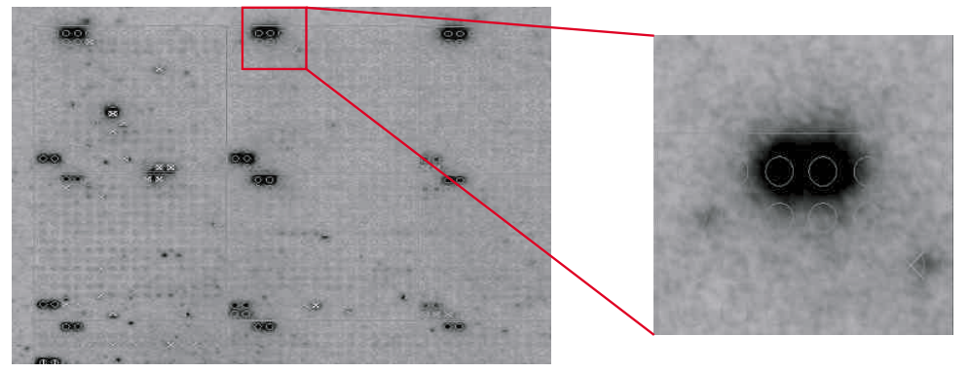
Module 1: background corrections to reduce smear contaminations

Slide 7
Module 1: background corrections to reduce smear contaminations
Two methods can reduce the artifacts in local background:
Manually adjust the grid size to fit the circles to each individual spot: A larger spot size can diminish the signal of the spot because the signal density decreases with increasing spot size and requires considerable time and effort.
Background correction applied in ProCAT : Replaces the background intensity of the central spot with the background from its local neighborhood. A three by three surrounding window is assigned to each protein spot, and the median background of the nine spots will be used as the 'neighborhood background' value for the central spot .

Slide 8
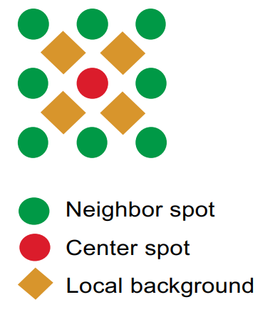
Module 1: background corrections to reduce smear contaminations

Slide 9
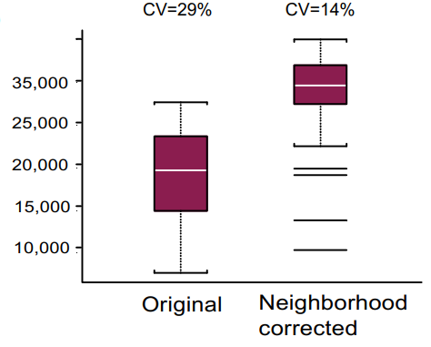
Module 1: background corrections to reduce smear contaminations
Applied the neighborhood background correction to the PKA(蛋白激酶A) spots. As expected, the median for PKA signal intensities was enhanced by 53%. Furthermore, the PKA signals from different positions are more similar to each other; the variance within them is decreased by 41% (p value = 0.006).
Notes:
the ratio of the standard deviation to the mean

Slide 10
Module 2: two-parameter signal normalization approach in sliding windows
Two parameters, the median and the median absolute deviation (MAD), are calculated to represent the signal distribution in the local window.
To normalize the slide with several different parameters. Five window sizes were tested, termed windows 1, 3, 5, 7, and 9. These numbers correspond to the window size as a function of the number of spots on one edge of a block.
For example, a block of 20 by 20 spots analyzed using window 1 would have a window size of 0.1 that of the block edge, or in this case 2 spots above, below, and to either side of the central spot , whereas a window size of 9 would contain a 37 by 37 area. ((20*0.9)*2+1=37)

Slide 11
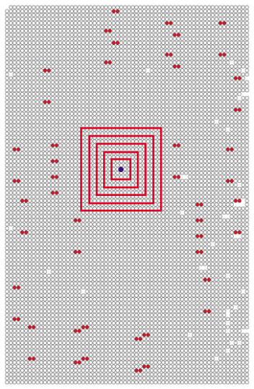
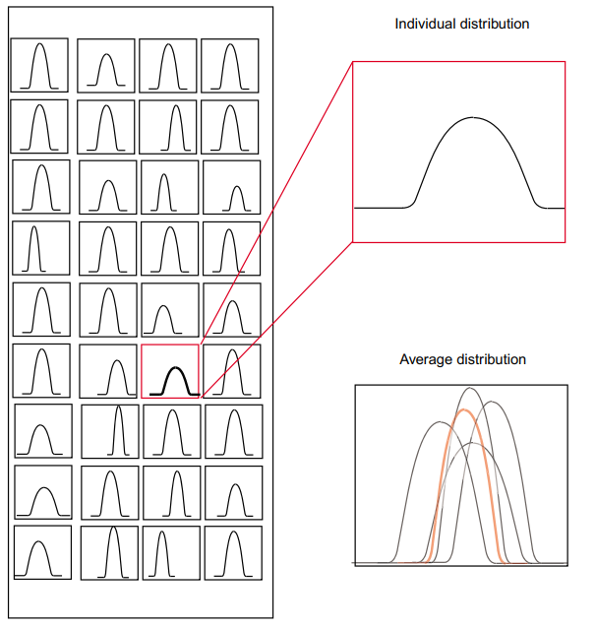
Module 2: two-parameter signal normalization approach in sliding windows

Slide 12
Module 2: two-parameter signal normalization approach in sliding windows
Decrease of signal variation suggests that a large scaling window will help to reduce spatial artifacts. Although larger window sizes are possible, 9 was used as the default number for ProCAT because the analysis can be done in a reasonable time and minimal improvement has been achieved after window size 7 .
In a protein slide with N rows and M columns, a local window W_{i,j} around one spot (i, j) is defined as signals of a set of spots, S_{i,j} that satisfy:
where f_{block} represents the number of spots on one edge of the block, and f_{win} is chosen by users from five options: 1, 3, 5, 7 and 9.

Slide 13
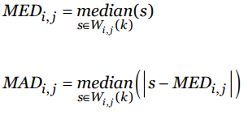
Module 2: two-parameter signal normalization approach in sliding windows
After calculating MED_{i,j} and MAD_{i,j} for all the spots on the array, they are averaged to obtain the two parameters MED
and for the reference distribution. For one spot (i, j), ProCAT normalizes its raw signal S_{i,j} by comparing MED_{i,j} and MAD_{i,j} with the average values:

Slide 14
Module 2: two-parameter signal normalization approach in sliding windows

Slide 15
Module 3: local window to identify positive spots
For a given spot at row i and column j, its normalized signal is compared to surrounding spots in a nine by nine window W_{ij}(4). Signals within this window are fit to a normal distribution. The mean μ_{i,j} and standard deviation σ_{i,j} will be calculated and the default threshold is set at two standard deviations above the signal mean. A spot (i, j) will be called positive only if its signal is above the threshold:

Slide 16
Module 3: local window to identify positive spots
When many spots with strong signals are included in the window, the cutoff will be arbitrarily high and thus decrease the sensitivity of detecting positive spots by the program. To avoid this loss in sensitivity, ProCAT has a built in function to identify possible outliers, to remove those outlier spots that have extremely strong signals, and then to calculate a cutoff for identifying positive spots using the remaining spots.

Slide 17
Module 3: local window to identify positive spots
When positive spots are likely to be close to each other, ProCAT uses box plots to examine and remove possible outliers from the surrounding window . Let Q1 be the lower quartile (25th percentile) and Q2 be the upper quartile (75th percentile); the difference between Q1 and Q2 is termed interquartile range ΔQ. A spot (i', j') is then defined as an outlier if its signal:
Ŝ_{i', j'} > Q₂ + 1.5ΔQ or Ŝ_{i', j'} < Q₁ - 1.5ΔQ

Slide 18
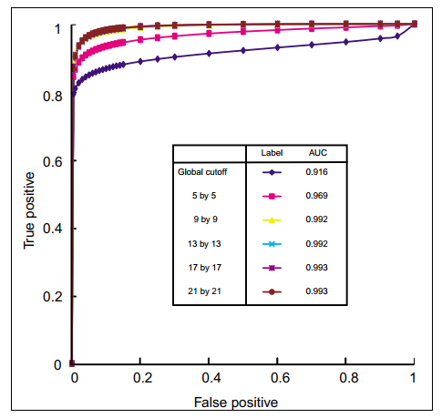
Module 3: local window to identify positive spots
Using GST-Sla2p and GSTMyo4p as positive controls and BSA as negative controls. Five window sizes were tested and compared with the global cutoff. Prediction performance is increased significantly when using local windows with nine or more spots on one edge. Thus, a nine by nine window is used as the default in ProCAT since a larger window size results in increased computing time with only minimal improvement in sensitivity.

Slide 19
Module 4, 5: filter module; negative control and quality control as filters
First, all positive spots from negative control experiments are removed. Spots that produce signals in the absence of active kinase were identified by ProCAT and removed from the target lists of kinase probings.
Notes:
*****

Slide 20
Module 4, 5: filter module; negative control and quality control as filters
The second filter checks the quality of each positive spot. ProCAT then uses the difference between duplicate signals as an indicator of the signal qualities. The difference between signals of two duplicate spots (s₁, s₂) is calculated as (s₁ + s₂)/(|s₁| + |s₂|) and then fitted to a normal distribution.
Proteins with exceptionally large differences in their duplicate spots are more likely to be biased by certain artifacts, and thus are removed from the positive list. The default threshold for the duplicate spot difference in ProCAT is set at two standard deviations away from the mean.

Slide 21
Module 6: protein amount normalization
One of the goals for protein microarray experiments is to identify the affinity of a binding interaction or the extent of phosphorylation. Ideally, the spot intensity would directly correspond to the strength of interaction.
After background correction and signal normalization, the raw signals can be standardized by relative protein amounts before they can be used to estimate the interaction strength.
Probing with anti-epitope antibodies will provide an estimate of the relative protein amounts in each spot on the array.

Slide 22
Module 6: protein amount normalization
After the protein amount is determined for one spot at row i and column j, ProCAT divides the raw signal intensities S_{i,j} by the protein amount signals A_{i,j} and uses the quotient as an approximation of the strengths of interactions:
Only proteins with amounts more than a minimal cutoff and signal intensities lower than a saturation threshold will be normalized with protein amounts. Proteins that do not conform to these two requirements will be recorded with unnormalized signals .

Slide 23
Conclusion
ProCAT includes novel scaling methods that provide robust and reproducible measurement for quantitative signals.
By calling positive candidates locally, ProCAT demonstrated excellent performance in identifying positives in comparison to global thresholds.
ProCAT uses a local three by three window to correct background. This method assumes the artifacts are sparse enough so that the majority of the nine spots in the local window still provide correct measurements of the background signals.

Slide 24
Conclusion
A key aspect of ProCAT is the two-parameter (MED, MAD) approach for reducing spatial nonuniformity.
It diminishes the signal intensity if the spot is located in a high signal neighborhood, while compensating the intensity if it is in a low signal neighborhood.
The size of the neighborhood window can also largely affect the performance of the normalization. We found that the optimal window size of ProCAT is 9 for protein-protein interactions.

